Slide 1
Saint Matthew Island Blue King Crab Assessment Sept 2017
James Ianelli D’Arcy Webber Jie Zheng and Alathea Letaw

Slide 2
Gmacs progress
Updated changes to work with modifications made for BBRKC
Included “Dynamic Bzero” computation
New plotting functions in gmr
Updated SMBKC document and BBRKC (presented in May)

Slide 3
Data

Slide 4
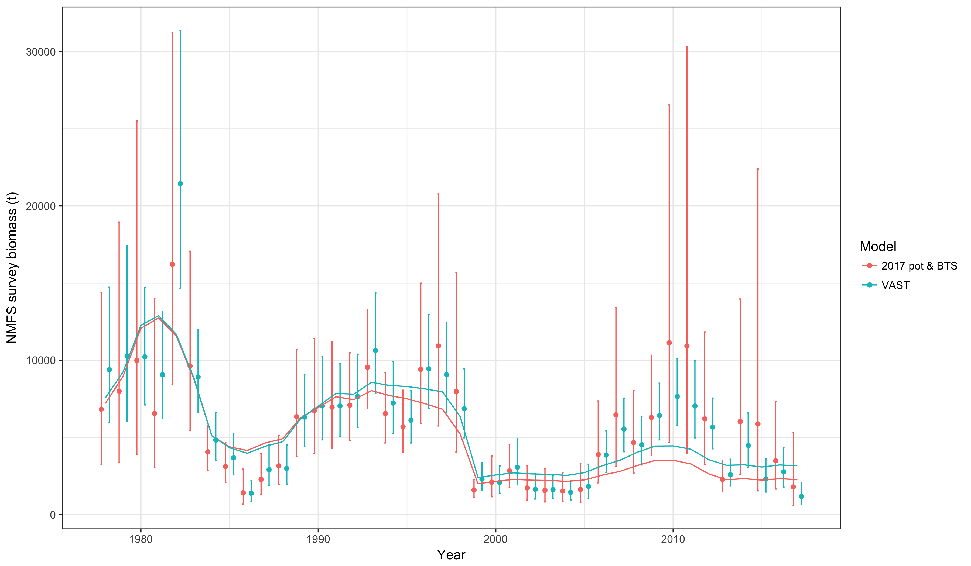

Slide 5
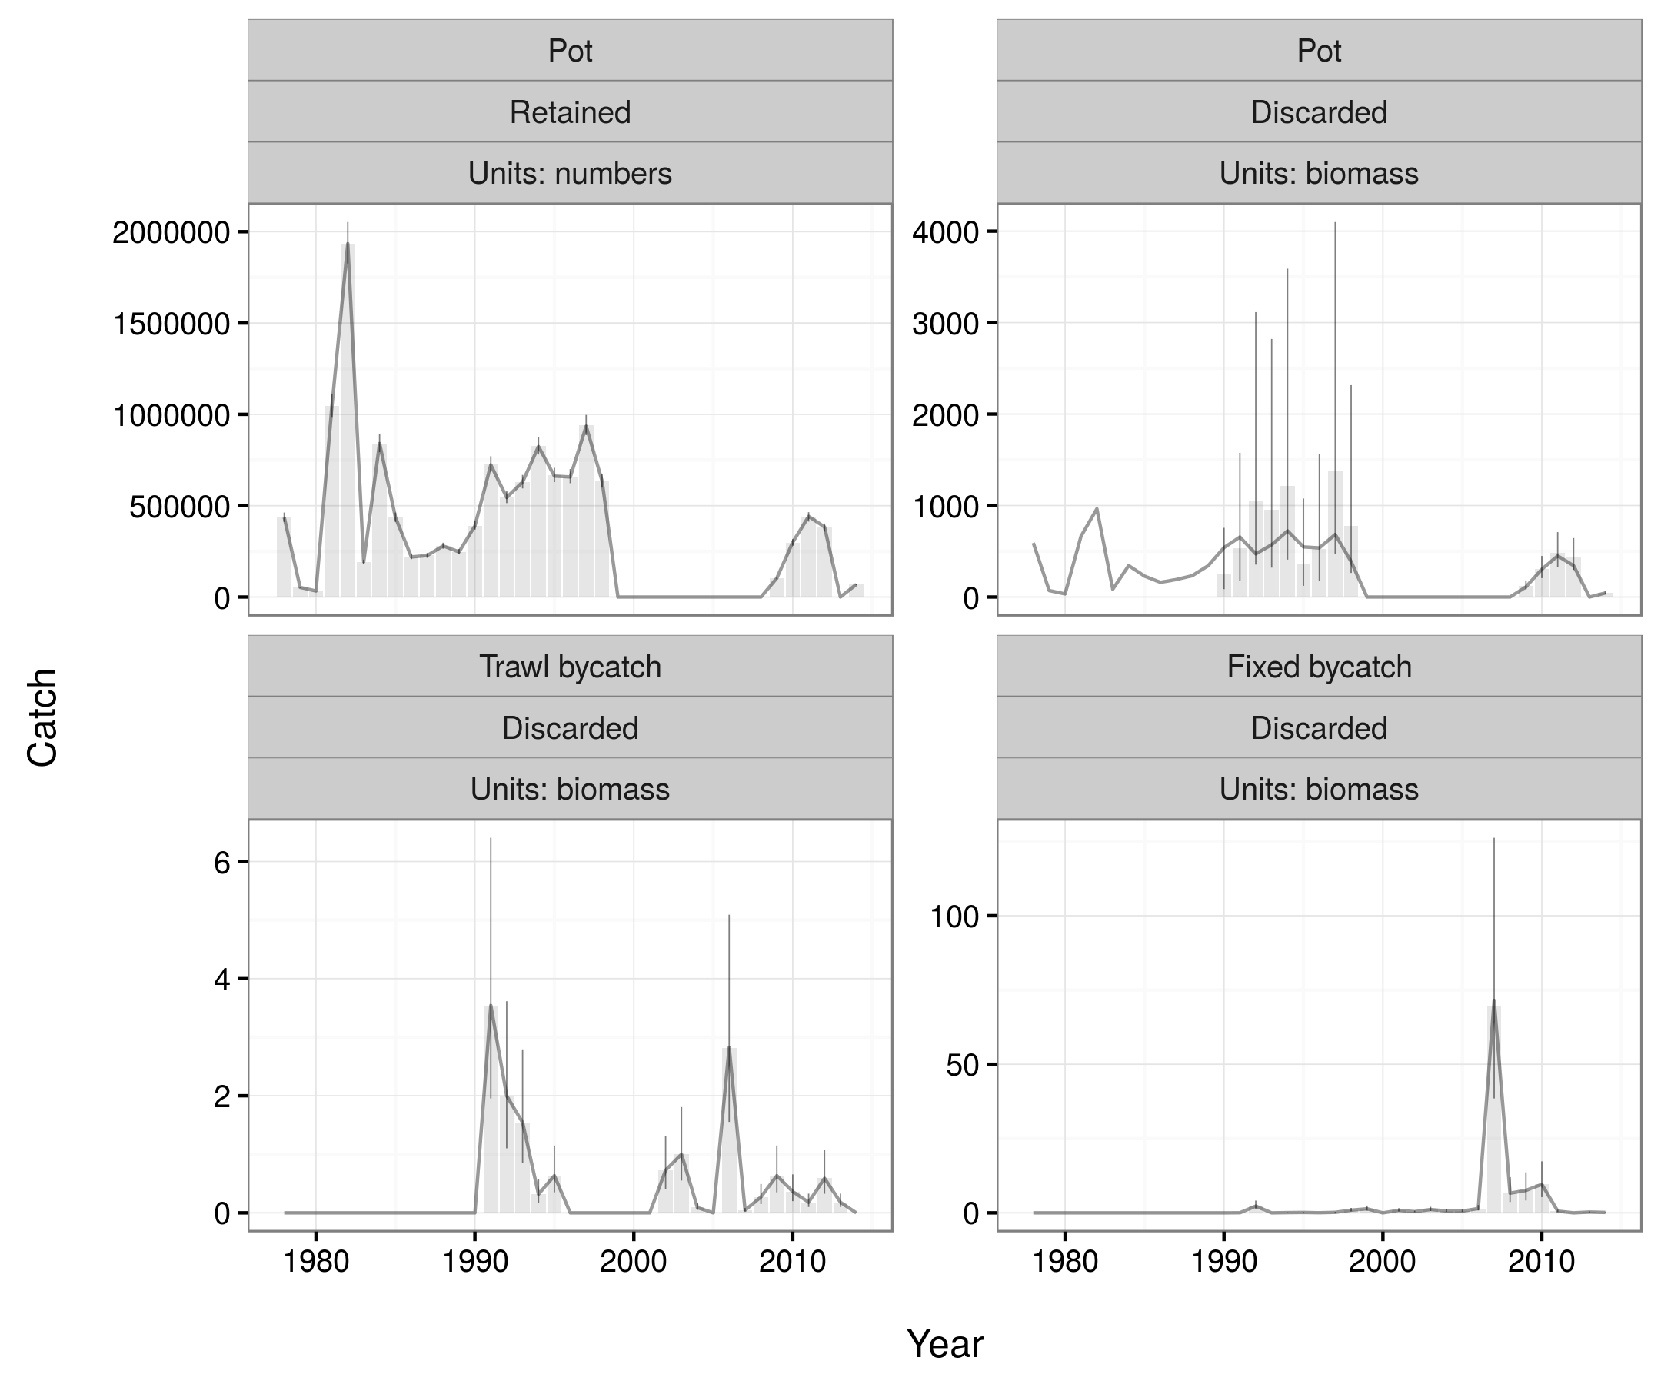
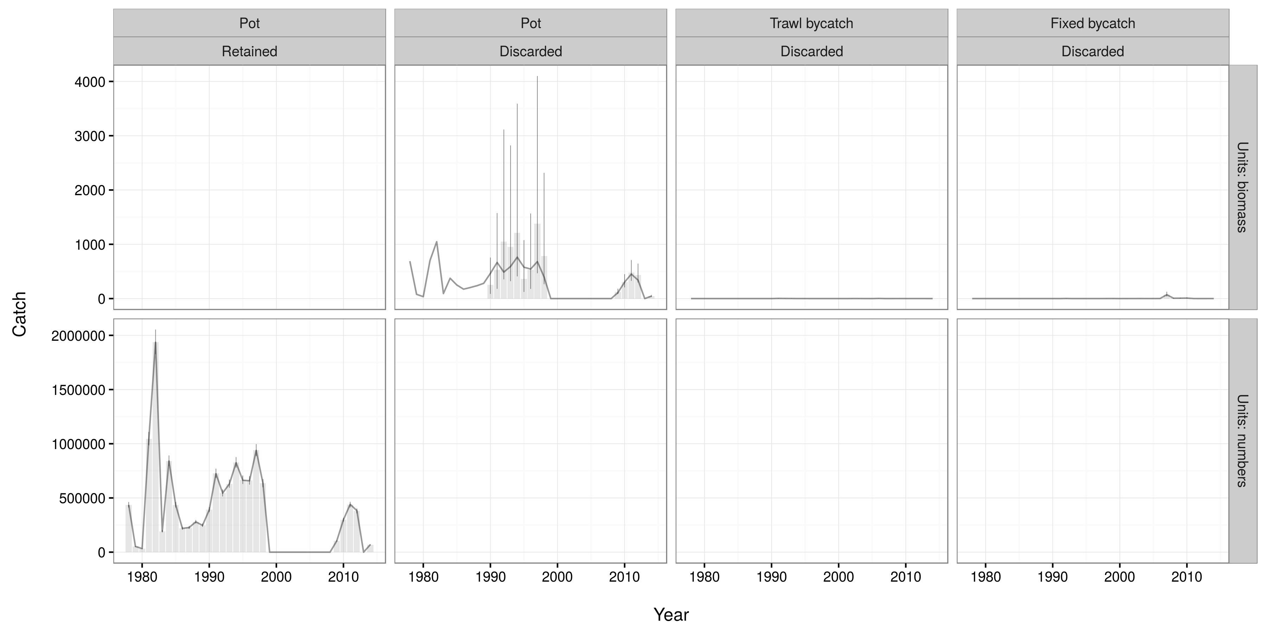

Slide 6
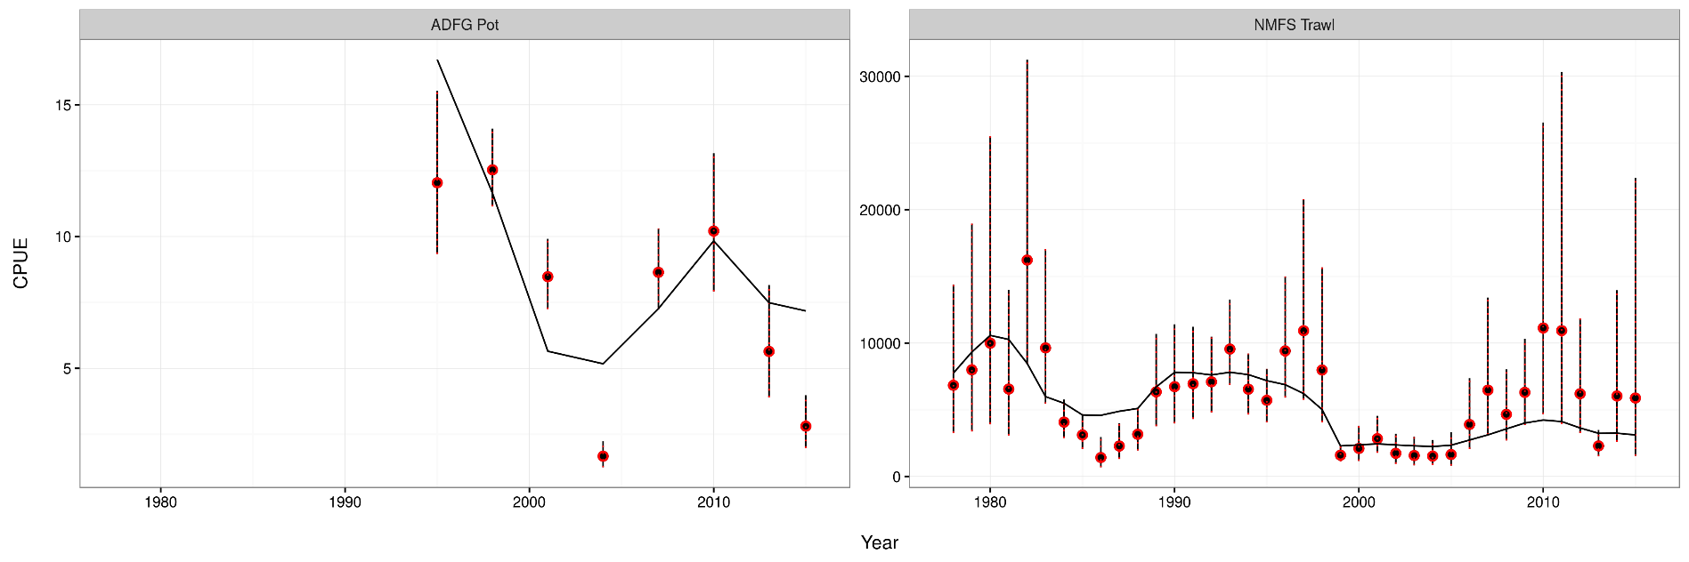
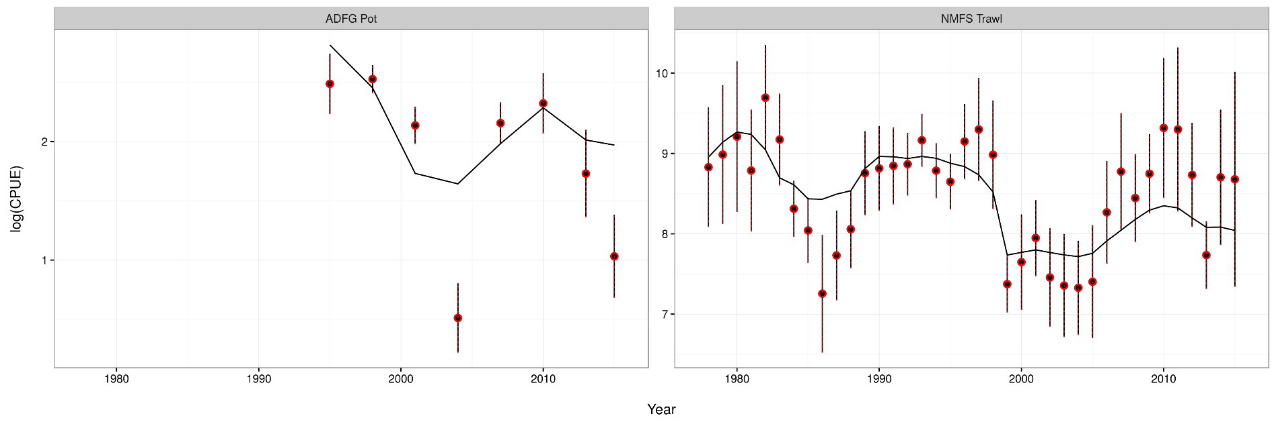

Slide 7
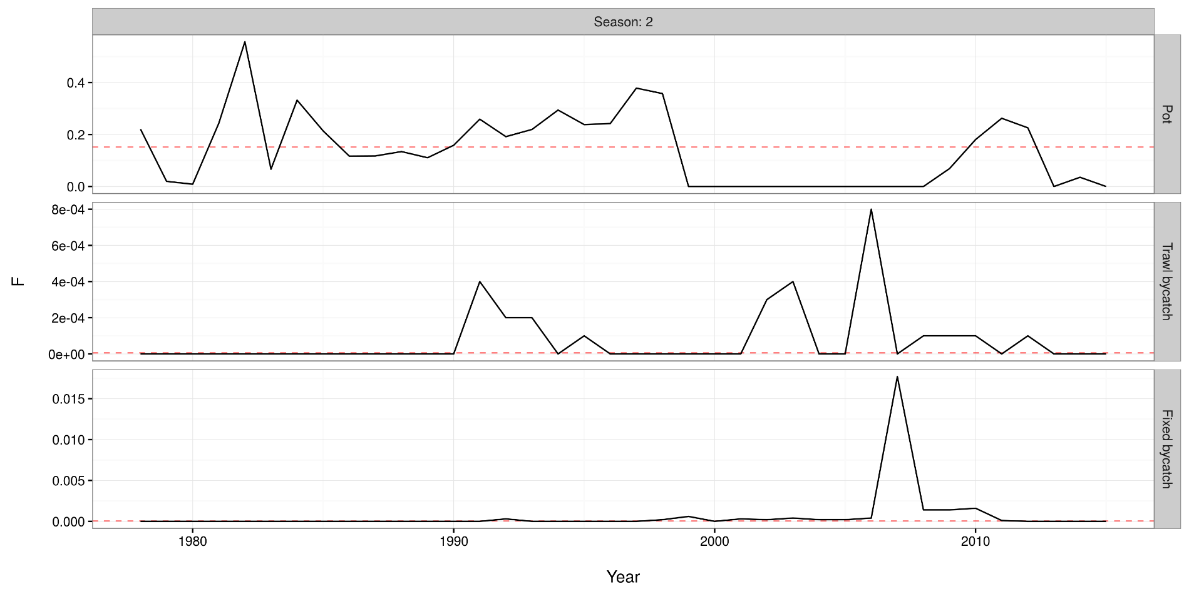

Slide 8
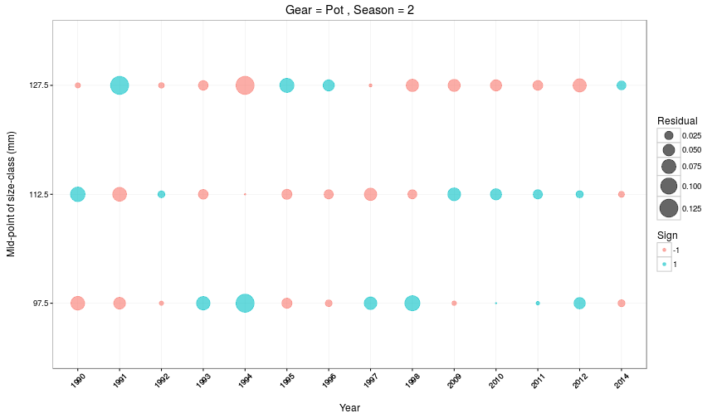

Slide 9
SMBKC in Gmacs
1978-2017
4 seasons (M = 0, 0.44, 0.185, 0.375)
3 stages (90-104, 105-119, 120+)
1 sex, 1 shell type, 1 maturity class
3 fleets (pot, trawl bycatch, fixed bycatch)
2 surveys (NMFS trawl and ADF&G pot CPUE) both in season 1
4 catch types (directed pot, pot discards, trawl bycatch, fixed bycatch) all during season 2
3 size compositions (pot in season 2, NMFS trawl in season 1, ADF&G pot in season 1)

Slide 10
SMBKC dynamics
Season 1
1 July, start of fishing year
Surveys
Season 2
M=0.44 & catch (note that this differs from 2015 model)
Season 3
M=0.185
Calculate MMB
Season 4
M=0.375
Growth and molting
Recruitment (all to stage-1)

Slide 11
Data

Slide 12
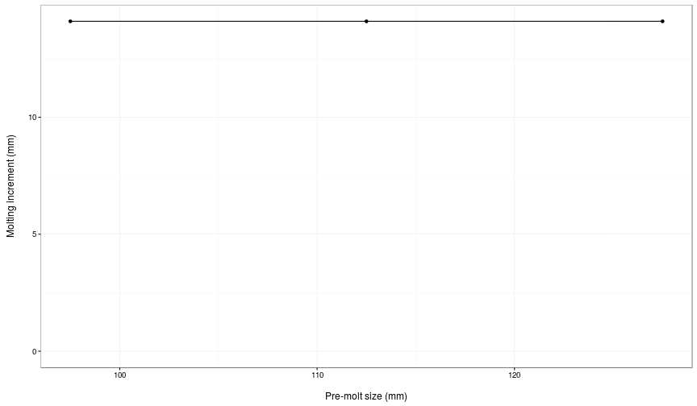
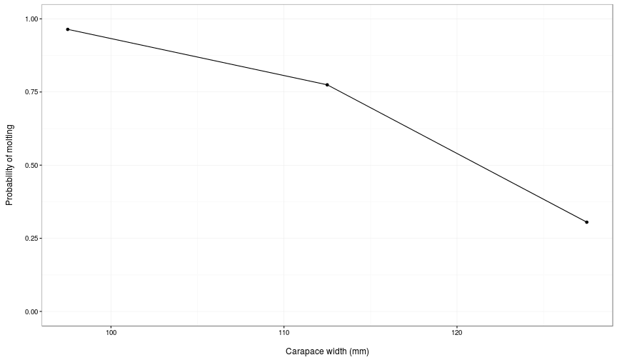

Slide 13
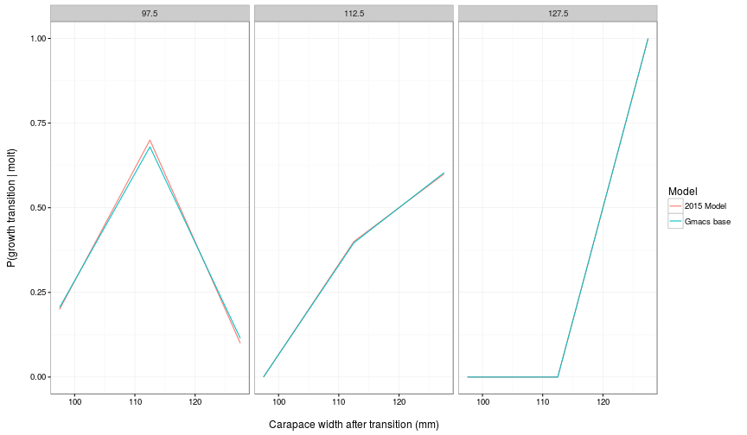
Size transition matrix

Slide 14
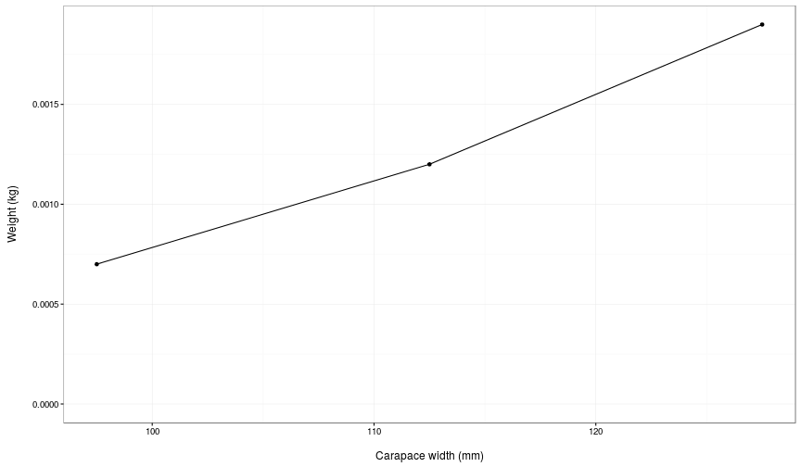
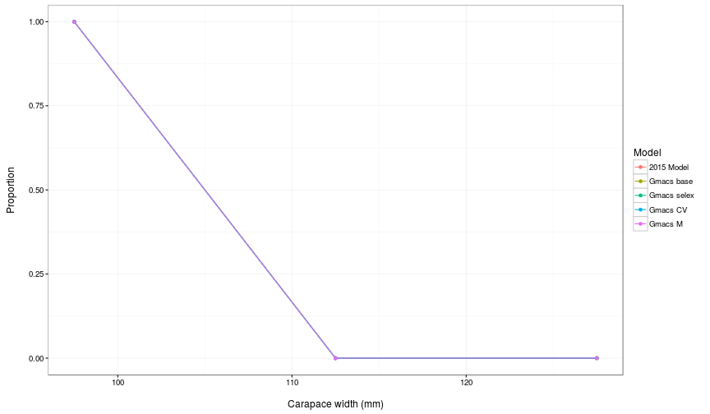

Slide 15
SMBKC
Jump to document.
Start with table of model runs.

Slide 16
What else would people like to see?
Model runs:
Estimate M₁₉₉₈ but with smaller SD constraining deviation?
Fix stage-2 selectivity at 1.0 (rather than stage-1) if estimated stage-2 selectivity > 1.0
Plots…

Slide 17
Tests
Checked that pars that are not used are off
Did some “jittering” to check for local minima
Implemented time-varying weight by stage (permanent)
Implemented time-varying season length (temporary, but do we wish to retain this feature?)
Added another season to SMBKC model that has M=0 and all of fishing mortality (i.e. pulse) after variable season length
Fixed initial conditions, average recruitment, recruitment deviations, and M_{1998/99} to the values estimated in 2015 model
Tried running the model using the same units as 2015 model

Slide 18
SMBKC dynamics
Season 1
1 July, start of fishing year
Surveys
Season 2
Variable proportion of natural mortality
Season 3
Fishing mortality
Season 4
Variable proportion of natural mortality
Calculate MMB
Season 5
Proportion of natural mortality = 0.375
Growth and molting
Recruitment (all to stage-1)

Slide 19
0.000 0.070 0.000 0.560 0.370
0.000 0.060 0.000 0.570 0.370
0.000 0.070 0.000 0.560 0.370
0.000 0.050 0.000 0.580 0.370
0.000 0.070 0.000 0.560 0.370
0.000 0.120 0.000 0.510 0.370
0.000 0.100 0.000 0.530 0.370
0.000 0.140 0.000 0.490 0.370
0.000 0.140 0.000 0.490 0.370
0.000 0.140 0.000 0.490 0.370
0.000 0.140 0.000 0.490 0.370
0.000 0.140 0.000 0.490 0.370
0.000 0.140 0.000 0.490 0.370
0.000 0.180 0.000 0.450 0.370
0.000 0.140 0.000 0.490 0.370
0.000 0.180 0.000 0.450 0.370
0.000 0.180 0.000 0.450 0.370
0.000 0.180 0.000 0.450 0.370
0.000 0.180 0.000 0.450 0.370
0.000 0.180 0.000 0.450 0.370
0.000 0.180 0.000 0.450 0.370
0.000 0.180 0.000 0.450 0.370
0.000 0.180 0.000 0.450 0.370
0.000 0.180 0.000 0.450 0.370
0.000 0.180 0.000 0.450 0.370
0.000 0.180 0.000 0.450 0.370
0.000 0.180 0.000 0.450 0.370
0.000 0.180 0.000 0.450 0.370
0.000 0.180 0.000 0.450 0.370
0.000 0.180 0.000 0.450 0.370
0.000 0.180 0.000 0.450 0.370
0.000 0.440 0.000 0.190 0.370
0.000 0.440 0.000 0.190 0.370
0.000 0.440 0.000 0.190 0.370
0.000 0.440 0.000 0.190 0.370
0.000 0.440 0.000 0.190 0.370
0.000 0.440 0.000 0.190 0.370
0.000 0.440 0.000 0.190 0.370

